Slide 1

Getting Started With Ansible:
| DEVOPS NIGHTS
Agentless Configuration
Florentiu Ilie
December 2024

Slide 2



WHO WE ARE
10,000+ experts in 58 offices globally, working on ~ 1,000 cool projects.
SWEDEN
CANADA
UNITED KINGDOM
POLAND
GERMANY
UKRAINE
ROMANIA
ITALY
USA
SPAIN
BULGARIA
MEXICO
UAE
SINGAPORE
COLOMBIA
IN ROMANIA
~110 PEOPLE
3
OFFICES
CHILE

Slide 3



Who am I?
Florentiu Ilie
DevOps Engineer
Computer Science, Politehnica Timisoara
Linux enthusiast

Slide 4
CONTENT
WHAT IS ANSIBLE?
HOW TO START
PLAYBOOKS
ROLES
INVENTORY
VARIABLES
TEMPLATES
ENTERPRISE TOOLS

Slide 5
WHAT IS ANSIBLE?
| DEVOPS NIGHTS
01.

Slide 6


WHAT IS ANSIBLE?
Open-source automation tool, or platform,
used for IT tasks
Free: Ansible is an open-source tool
Simple to use: No special coding skills are necessary to use Ansible’s playbooks
Powerful: Ansible lets you model even highly complex IT workflows
Flexible: You can orchestrate the entire application environment
Agentless: You don’t need to install any other software
Efficient: More room for application resources on your server because no extra packages are needed

Slide 7
HOW TO START?
| DEVOPS NIGHTS
02.

Slide 8
HOW TO START
PACKAGE INSTALLATION:
Install package on central server (ex: stepping stone, bastion host): python, python-pip, ansible
Use pip to install modules for python & ansible
CONFIGURATION
/etc/ansible/ansible.cfg
/etc/ansible/inventory or /etc/ansible/hosts/inventory
COMMANDS:
Ad-hoc: ansible test -m shell -a "uname -a“
Run a playbook: ansible-playbook play123.yml -e "target=test“
Download a community role: ansible-galaxy install thedumbtechguy.ping
Check documentation: ansible-doc module ( module = user, …. )

Slide 9
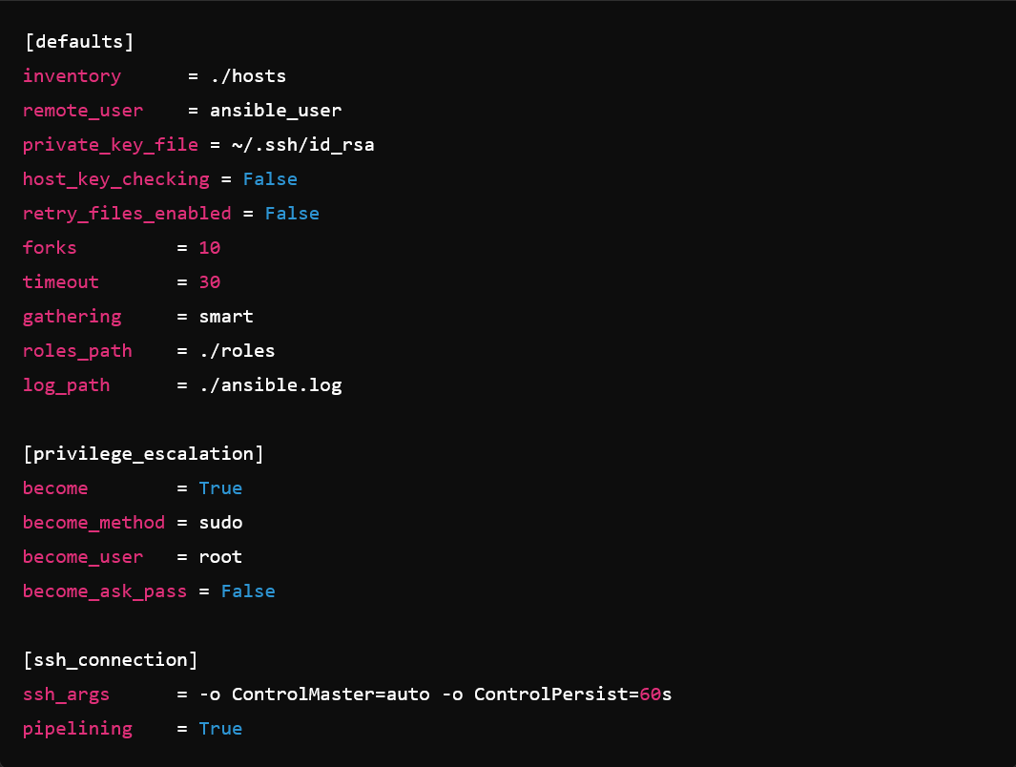
HOW TO START – ANSIBLE.CFG

Slide 10
PLAYBOOKS
| DEVOPS NIGHTS
03.

Slide 11
PLAYBOOKS
Playbooks define automation workflows: Written in YAML, playbooks describe the tasks to be executed.
Human-readable and declarative: Simple syntax makes them easy to write, read, and understand.
Organized into plays: Each play targets specific hosts, mapping tasks to roles or configuration steps.
Can handle complex workflows: Includes conditionals, loops, and error handling for advanced automation.
Central to automation: Playbooks are the core of how Ansible describes and executes desired states.

Slide 12
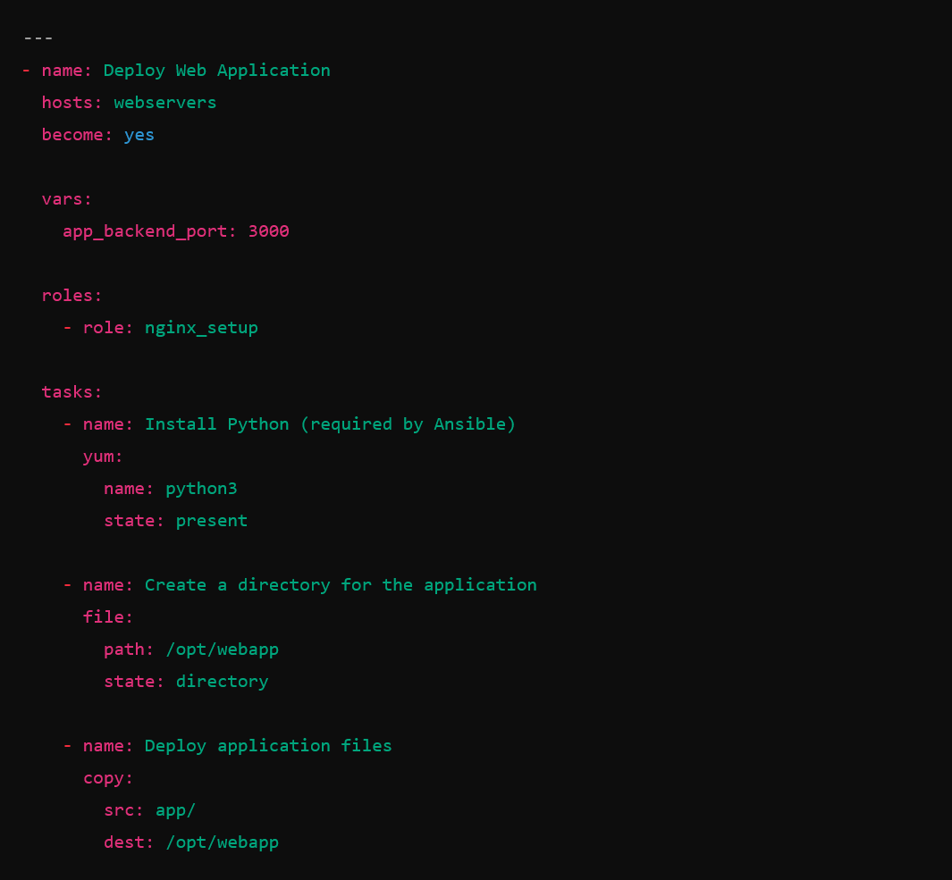
PLAYBOOKS - EXAMPLE

Slide 13
ROLES
| DEVOPS NIGHTS
04.

Slide 14
ROLES
Roles are reusable sets of tasks: Simplify automation by organizing tasks into reusable components.
Structured directories: Each role has a standard layout (tasks, handlers, templates, etc.).
Promotes modularity: Makes playbooks easier to read and maintain by breaking down into logical parts.
Easy to share: Roles can be shared across projects or teams and published in Ansible Galaxy.
Encourages best practices: Facilitates code reuse and consistency across your infrastructure.

Slide 15
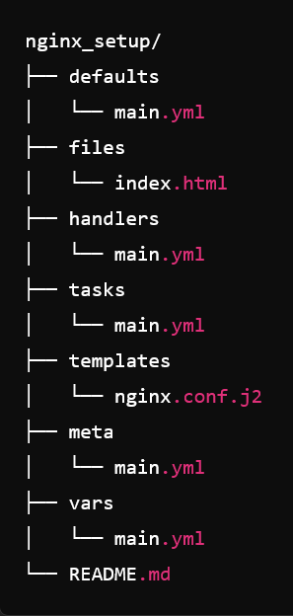
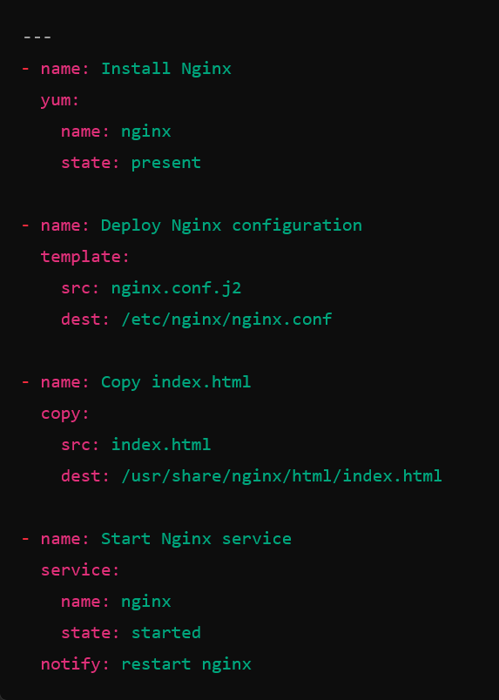
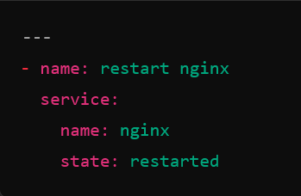
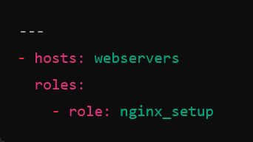
ROLES – EXAMPLE
Directory structure
tasks/main.yml
handlers/main.yml
How to use the role

Slide 16
INVENTORY
| DEVOPS NIGHTS
05.

Slide 17
INVENTORY
Organized as groups: Hosts can be grouped logically (e.g., web servers, databases).
Supports multiple formats: Static files (like INI, YAML) or dynamic inventory scripts.
Inventory is a collection of hosts: Defines the systems Ansible manages.
Hosts can have variables: Assign configuration values to groups or individual hosts.
Key component for targeting tasks: Allows you to run tasks on specific groups or hosts

Slide 18
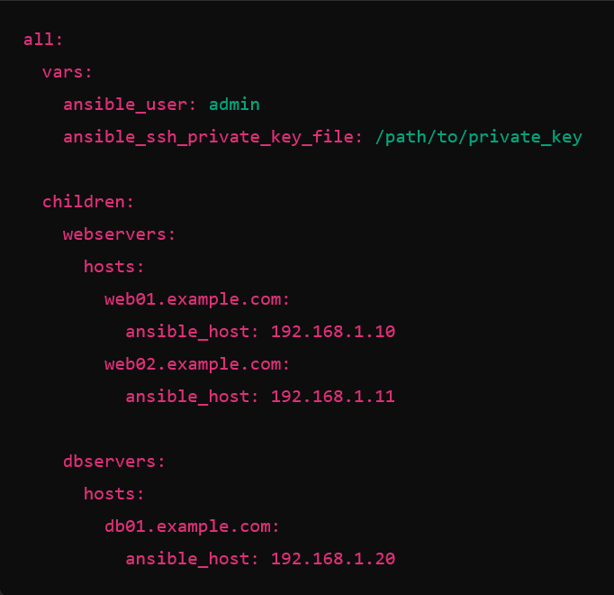
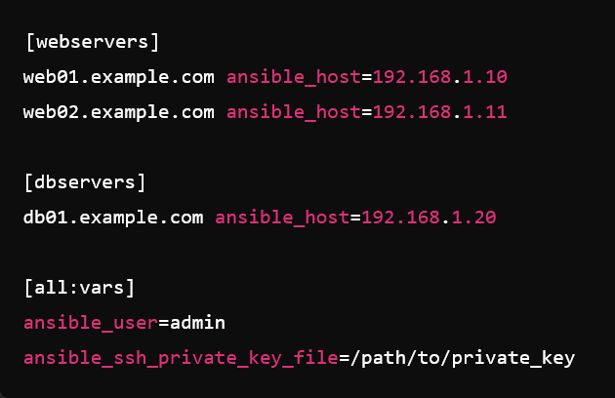
INVENTORY – EXAMPLE

Slide 19
VARIABLES
| DEVOPS NIGHTS
06.

Slide 20
VARIABLES
Variables store dynamic values: Customize configurations, making playbooks reusable and flexible.
Defined in multiple ways: Can be set in playbooks, inventory, roles, or passed as extra arguments.
Different variable scopes: Host, group, role, or global variables enable detailed control of configurations.
Override capabilities: Variables can be overridden based on precedence, giving flexibility in customization.
Use in templates and tasks: Makes playbooks adaptable to different environments and host types.

Slide 21
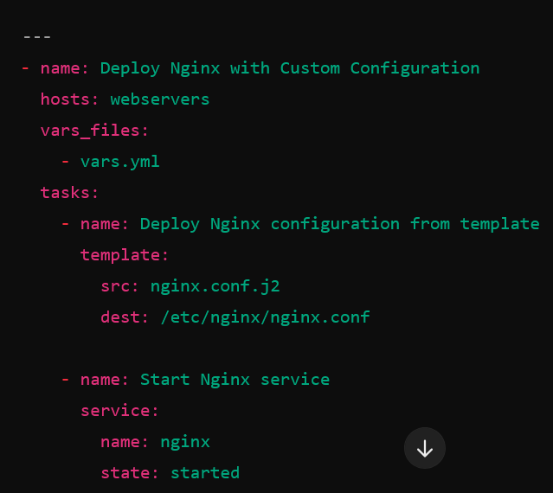
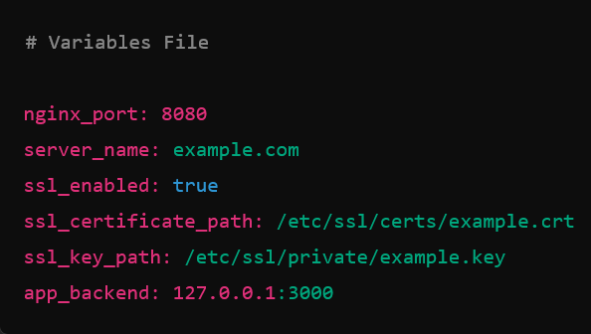
VARIABLES – EXAMPLE

Slide 22
TEMPLATES
| DEVOPS NIGHTS
07.

Slide 23
TEMPLATES
Templates use Jinja2 syntax: Dynamic files created from .j2 templates to customize configurations.
Generate configuration files: Adjust settings based on variables, making automation environment-specific.
Powerful templating engine: Jinja2 allows loops, conditionals, and filters for flexibility in templates.
Flexible deployment: Templates are rendered and pushed to hosts during playbook execution.
Adaptable and reusable: Facilitates reusing configurations across different systems with minimal changes.

Slide 24
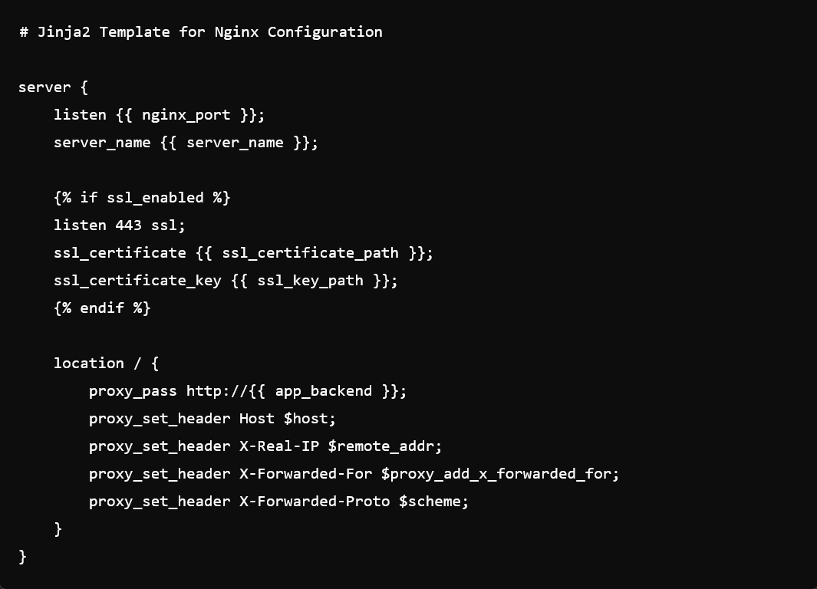
TEMPLATES - EXAMPLE

Slide 25
ENTERPRISE TOOLS
| DEVOPS NIGHTS
08.

Slide 26
ENTERPRISE TOOLS
Ansible Automation Platform (AAP) – A comprehensive enterprise solution for automation at scale, provided by Red Hat.
Ansible Tower – A centralized interface for managing and controlling Ansible across environments.
Ansible Collections – Collections are a way to package and distribute roles, modules, plugins, and more.
Ansible Automation Hub – The enterprise repository for certified content from Red Hat partners.
Integration with CI/CD and DevOps Tools – Jenkins, GitLab CI, and Azure DevOps

Slide 27

Thank you for participating!
| DEVOPS NIGHTS
Leave your feedback here:
Florentiu Ilie
December 2024

Slide 28


